Slide 1
Lecture 8
Interpolating functions

Slide 2

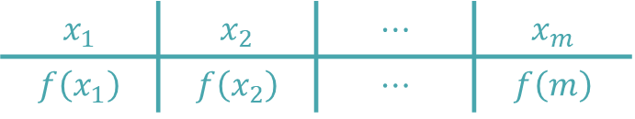
Introduction
In previous lectures we learned how to interpolate a data set with polynomial models
Interpolation can as well be used to interpolate a function $f(x)$ instead of a data set
$$x_{1}$$ | $$x_{2}$$ | $$⋯$$ | $$x_{m}$$
$$f\left(x_{1}\right)$$ | $$f\left(x_{2}\right)$$ | $$⋯$$ | $$f\left(m\right)$$
Notes:
In previous lectures we learned how to interpolate a data set with polynomial models
We discussed three approaches: Van der Mond, Newton and Lagrange interpolation.
All of them eventually did produce the same interpolation polynomial, only factorized in different ways
But interpolation can be used as well to approximate functions instead of data sets
In this case we choose n interpolations points x1 to xm.
The corresponding y values are the function values evaluated in these points
This is f(x1) to f(xm).

Slide 3
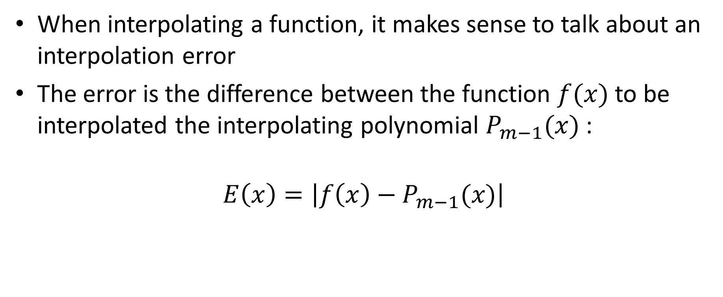
Interpolation error
When interpolating a function, it makes sense to talk about an interpolation error
The error is the difference between the function $f(x)$ to be interpolated the interpolating polynomial $P_{m−1}(x)$:
$$E\left(x\right)=\left|f\left(x\right)−P_{m−1}(x)\right|$$
Notes:
If we interpolate functions, it makes sense to talk about an interpolation error
The error is the difference between the function and the interpolating polynomial
In case of stat sets we could not define any interpolation error as we didn’t have a reference to be used as the true value of our problem.
In function interpolation we have that reference: it is the function we want to interpolate

Slide 4

Interpolation error
Theorem
If $P_{m−1}(x)$ is interpolating the $m$ points $\left(x_{i},f\left(x_{i}\right)\right)$ with $f\left(x\right)$ a function, then
$$f\left(x\right)−P_{m−1}\left(x\right)=\frac{\left(x−x_{1}\right)\left(x−x_{2}\right)…\left(x−x_{n}\right)}{m!}f^{m}(c)$$
with $c$ some number between the smallest and largest values of the interpolating points $x_{i}$
Notes:
There exist a theorem to estimate the interpolation error
It read as:
If $P_{m−1}(x)$ is interpolating the $m$ points $\left(x_{i},f\left(x_{i}\right)\right)$ with $f\left(x\right)$ a function, then
$$f\left(x\right)−P_{m−1}\left(x\right)=\frac{\left(x−x_{1}\right)\left(x−x_{2}\right)…\left(x−x_{n}\right)}{m!}f^{m}(c)$$
with $c$ some number between the smallest and largest values of the interpolating points $x_{i}$
Note that the number c will change if you evaluate the error in different points x. That is, c is a function of x

Slide 5


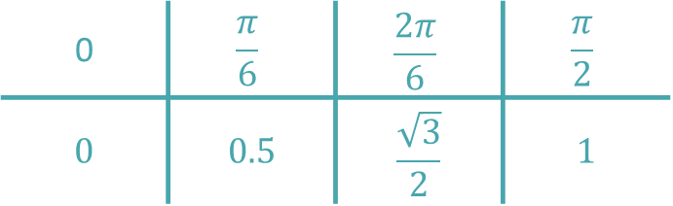
Example
Interpolate the sine function between 0 and $\frac{π}{2}$ with 4 equally spaced points
0 | $$\frac{π}{6}$$ | $$\frac{2π}{6}$$ | $$\frac{π}{2}$$
$$0$$ | $$0.5$$ | $$\frac{\sqrt{3}}{2}$$ | $$1$$
$$y=sin⁡(x)$$
Notes:
As an illustration we are going to interpolate the sine function 0 and $\frac{π}{2}$ with 4 equally spaced points
We first build a table which we will use as our data set for interpolation
Note that we did choose in our example the interpolating points in values where we know exactly the value of the sine function
This is in fact the idea behind function interpolation. We try to approximate the function based on points where we know exactly it’s value
With this table we can use any of the interpolating methods we have learned to find the interpolating polynomial
I invite you to try it by yourself
Next slide will give you the answer you should find

Slide 6


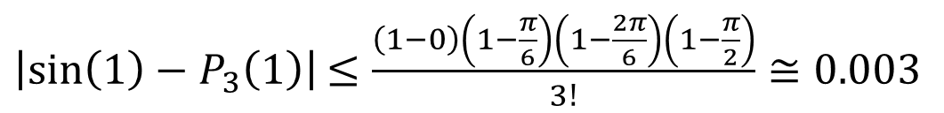
Example
Interpolating polynomial:
Error:
$$y=P_{3}(x)$$
$$P_{3}\left(x\right)=1.0204x−0.0655x^{2}−0.1139x^{3}$$
$$y=sin⁡(x)$$
At maximum equal to 1
$\left|\sin\left(x\right)−P_{3}\left(x\right)\right|=\frac{\left(x−0\right)\left(x−\frac{π}{6}\right)\left(x−\frac{2π}{6}\right)\left(x−\frac{π}{2}\right)}{3!}\left|\frac{d^{3}}{dx^{3}}sin⁡(c)\right|$ $≤\frac{\left(x−0\right)\left(x−\frac{π}{6}\right)\left(x−\frac{2π}{6}\right)\left(x−\frac{π}{2}\right)}{3!}$
$\left|\sin\left(1\right)−P_{3}\left(1\right)\right|$ $≤\frac{\left(1−0\right)\left(1−\frac{π}{6}\right)\left(1−\frac{2π}{6}\right)\left(1−\frac{π}{2}\right)}{3!}≅0.003$
Notes:
Using for example Van der Mond interpolation we can find the interpolating polynomial
As we had four interpolating points this gives us a cubic polynomial
With our theorem we can now estimate the interpolation error, which is the difference between the sin function and our interpolating polynomial
As the third derivative of the sine function is the sine function and that the sine function is limited between 0 and 1, we can give an upper boundary for this error
In the particular case of x=1, we find an upper boundary of 0.003
This means that if we use our interpolating polynomial to compute sin(1), then we make an error of maximum 0.003
I invite you to compare the value you get from P3(1) and sin(1) using your hand calculator.
Don’t forget to use radians.

Slide 7
Summary
Interpolation can be used to interpolate functions
When interpolating functions, it makes sense to talk about the interpolation error (difference between the function to be interpolated and the interpolating polynomial)
There exist a theorem which allows to estimate the interpolation error
Notes:
Let us summarize the key findings
Interpolation can be used to interpolate functions
When interpolating functions, it makes sense to talk about the interpolation error (difference between the function to be interpolated and the interpolating polynomial)
There exist a theorem which allows to estimate the interpolation error

